Slide 1
MongoDB Datatypes
Sandhya Rani

Slide 2
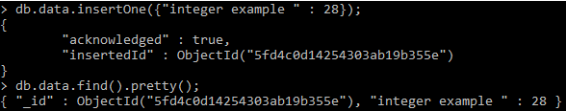
Integer

Slide 3
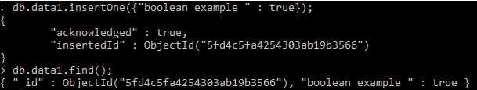
Boolean

Slide 4
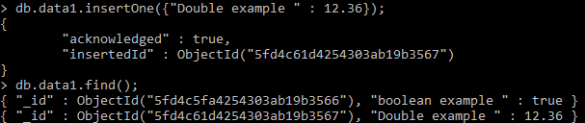
Double

Slide 5
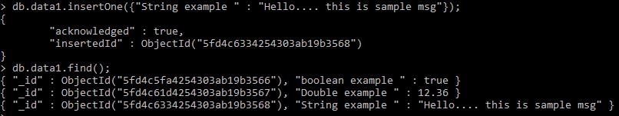
String

Slide 6
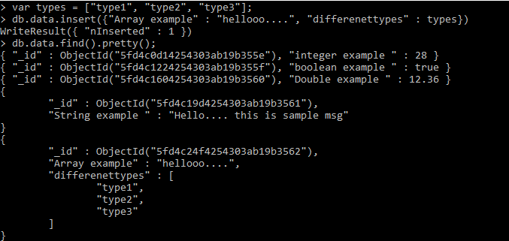
Arrays

Slide 7
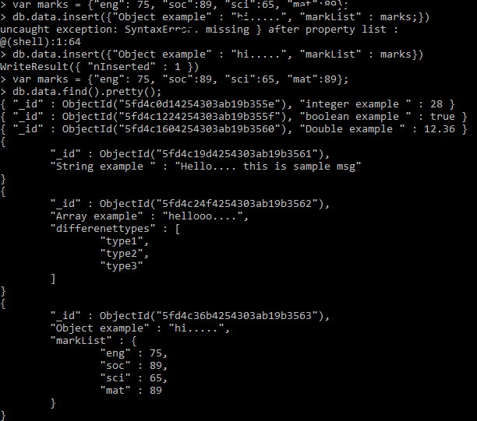
Object

Slide 8
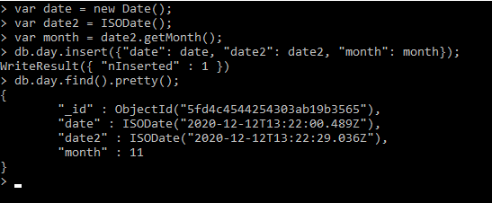
Date

Slide 9
Null
Object ID:
implemented for storing the ID of the document.
Binary data:
implemented for storing binary data.

